Slide 1
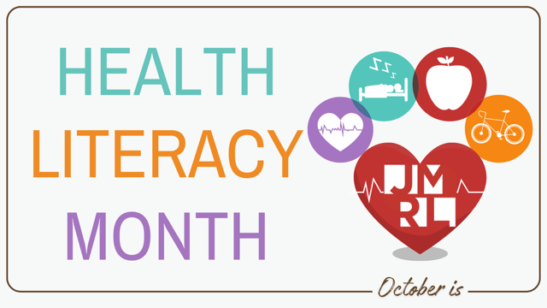
“Nearly 9 out of 10 adults struggle with health literacy.”
Network of the National Library of Medicine
LEKT (Team 227)

Slide 2
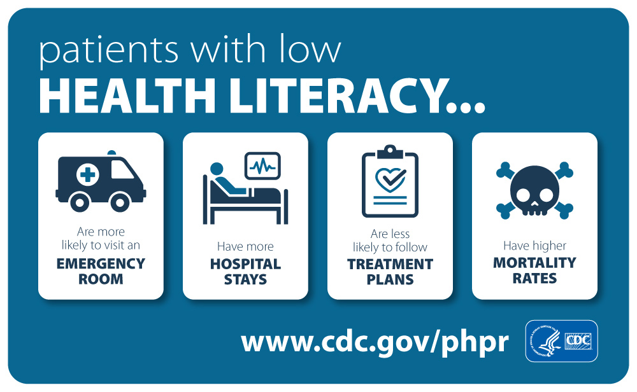
What is
Health Literacy?
The ability to find and understand basic health information, including common medical terms, and use that understanding to make informed and meaningful decisions about one's health.
Source: Ingram, 2018

Slide 3
Low Health Literacy
Low health literacy (LHL) is more common in communities that are:
Rural
Racially and ethnically
diverse
Lower levels of education
Socioeconomically challenged
Limited English proficiency; English as a second language (ESL)
Income, employment, transportation, food security, housing, etc.

Slide 4
Addressing Disparities Across San Diego County HHSA Regions
Central ・ East ・ North Central・North Inland・ North Coastal・South

Slide 5
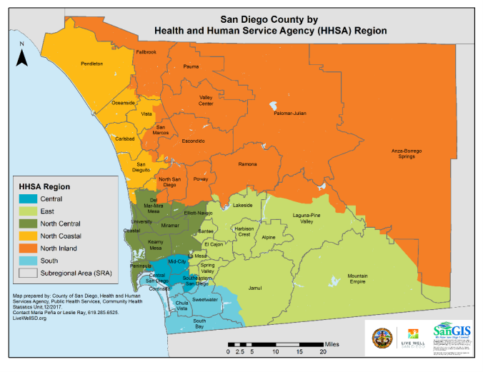
Cancer, heart disease, and other chronic diseases are the leading causes of death in San Diego County.
The Central and South regions, which together account for 30% of the county’s population, experience the greatest health disparities due to higher rates of poverty, unemployment, and lower levels of educational attainment.
**Note that some counties and SRAs within regions faced disproportionate rates of certain diseases.
Source: County of San Diego, 2022
Notes:
More information here - Lisa
The South region, home to a large Hispanic/Latino and immigrant population, faces unique healthcare access challenges, particularly due to its proximity to the U.S.-Mexico border, which exacerbates language barriers and other access issues.

Slide 6
Central Region
South/East Border Regions
1 in 3 Central Region residents were living below 200% FPL in 2022.
The Central region, one of the most diverse in San Diego County, faces significant health and socioeconomic challenges, including limited access to healthcare, lack of insurance coverage, and transportation barriers, despite its central location.
South Region had disproportionate rates of ED discharge and hospitalization due to chronic diseases compared to all other HHSA Regions in 2022.
The South and East regions have a large population of Hispanics/Latinos and immigrants. Its location by the U.S.-Mexico border creates challenges to access healthcare services due to the language barrier.
Source: County of San Diego, 2022
Notes:
Might consider dropping this slide due to length

Slide 7


Health education tailored to you
Notes:
Fun, interactive personalized plans (visuals, maps, videos, voice chats, multi-language, etc.) tailored to needs; provide optimism

Slide 8
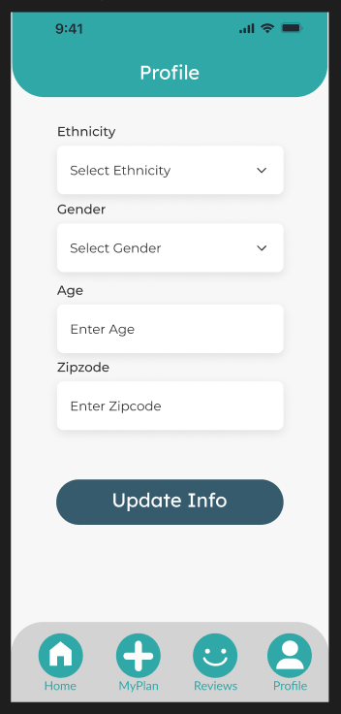
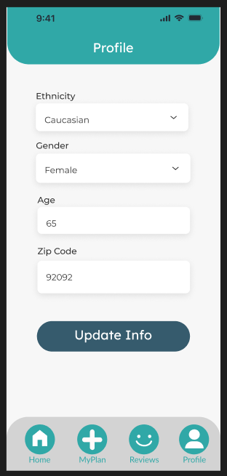
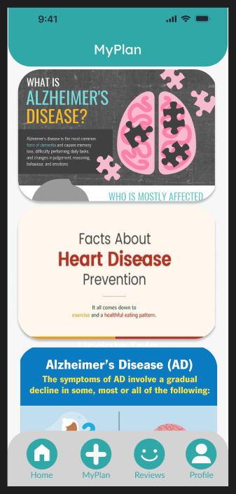

Slide 9
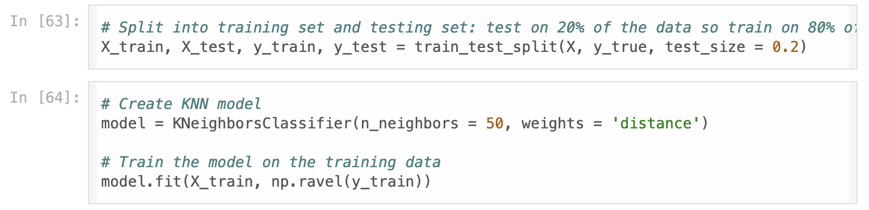
KNN Machine Learning Models

Slide 10
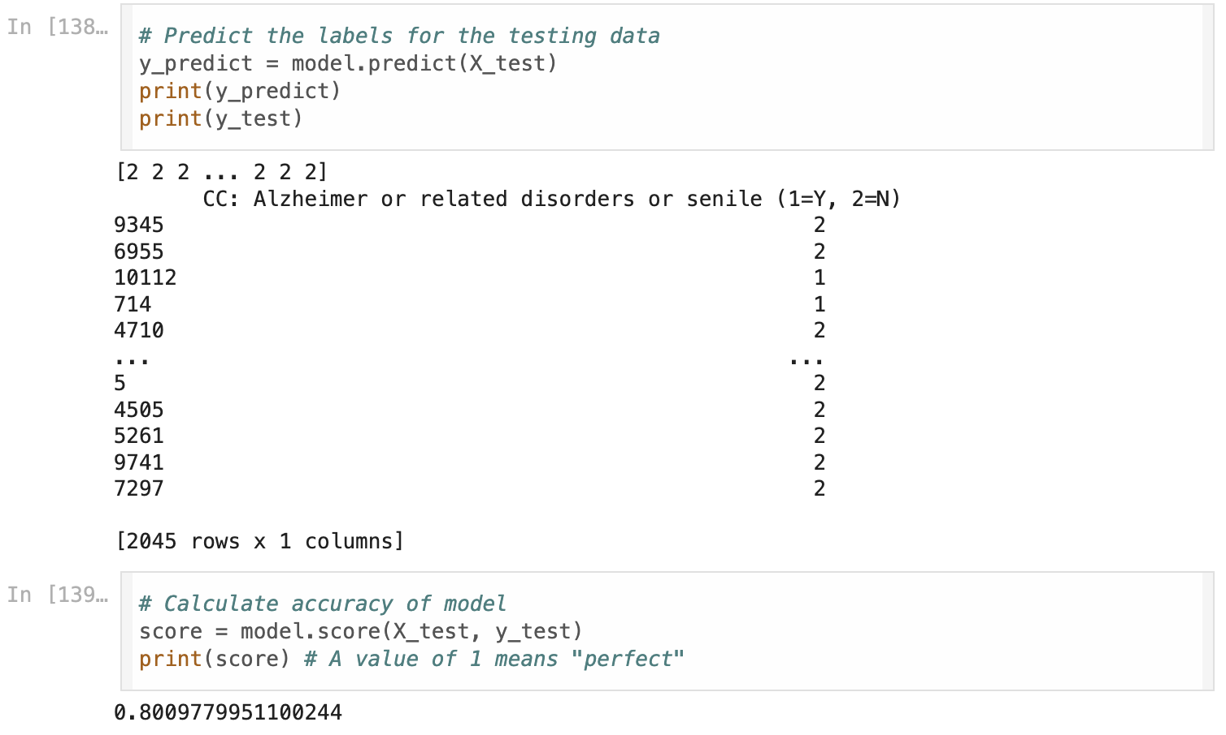
Predicting Risk for Alzheimer’s

Slide 11
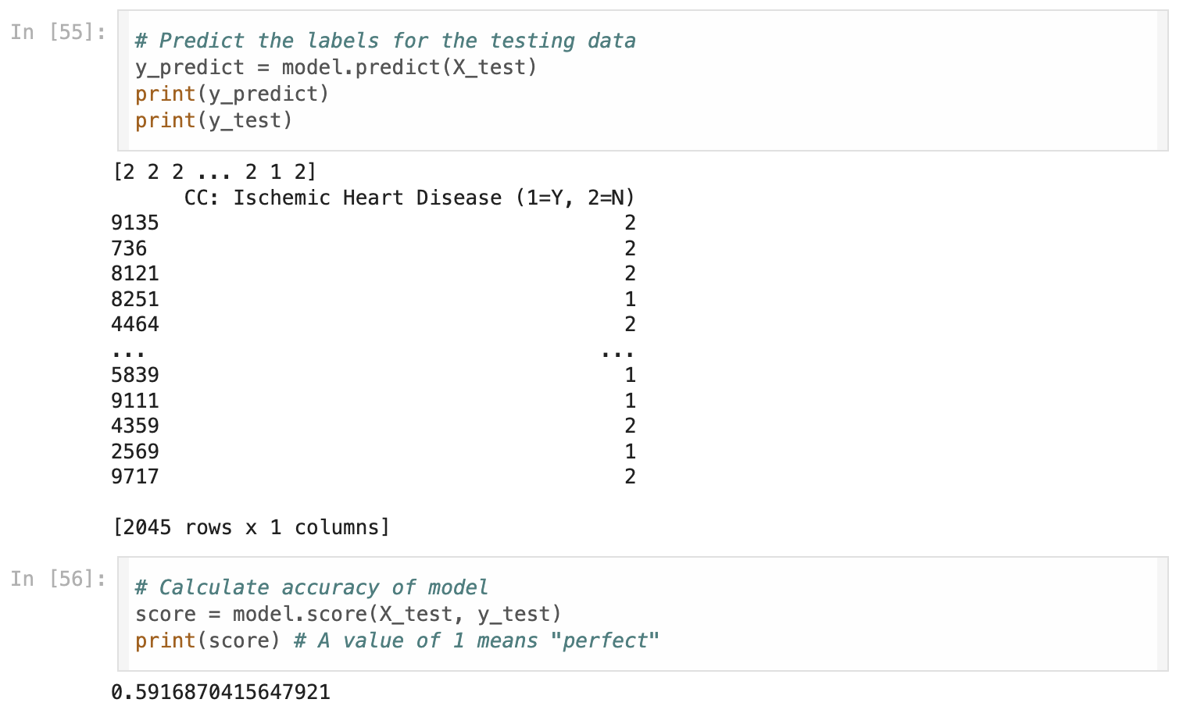
Predicting Risk for Heart Disease

Slide 12
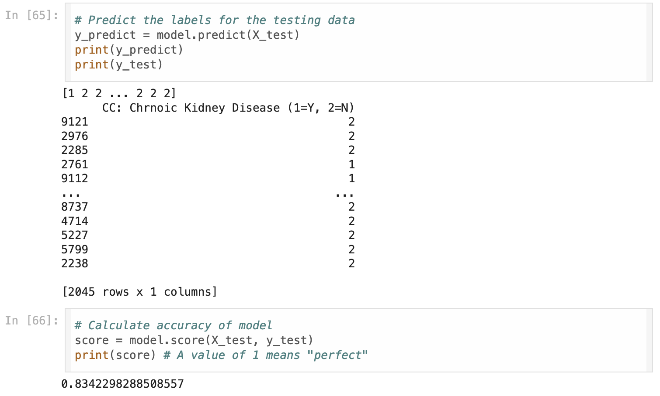
Predicting Risk for Kidney Disease

Slide 13
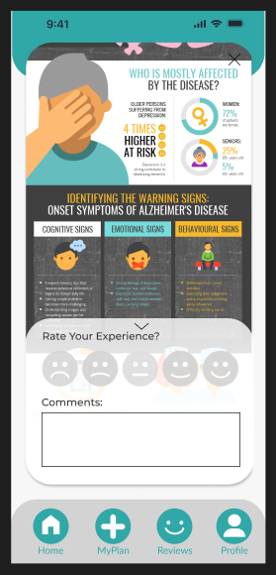
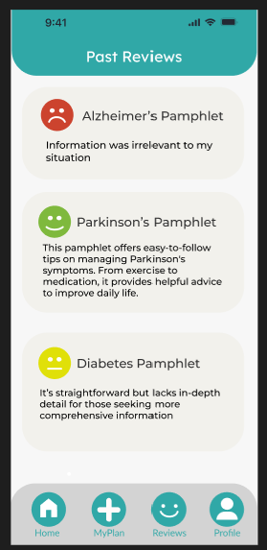
Patient Rating & Commenting

Slide 14
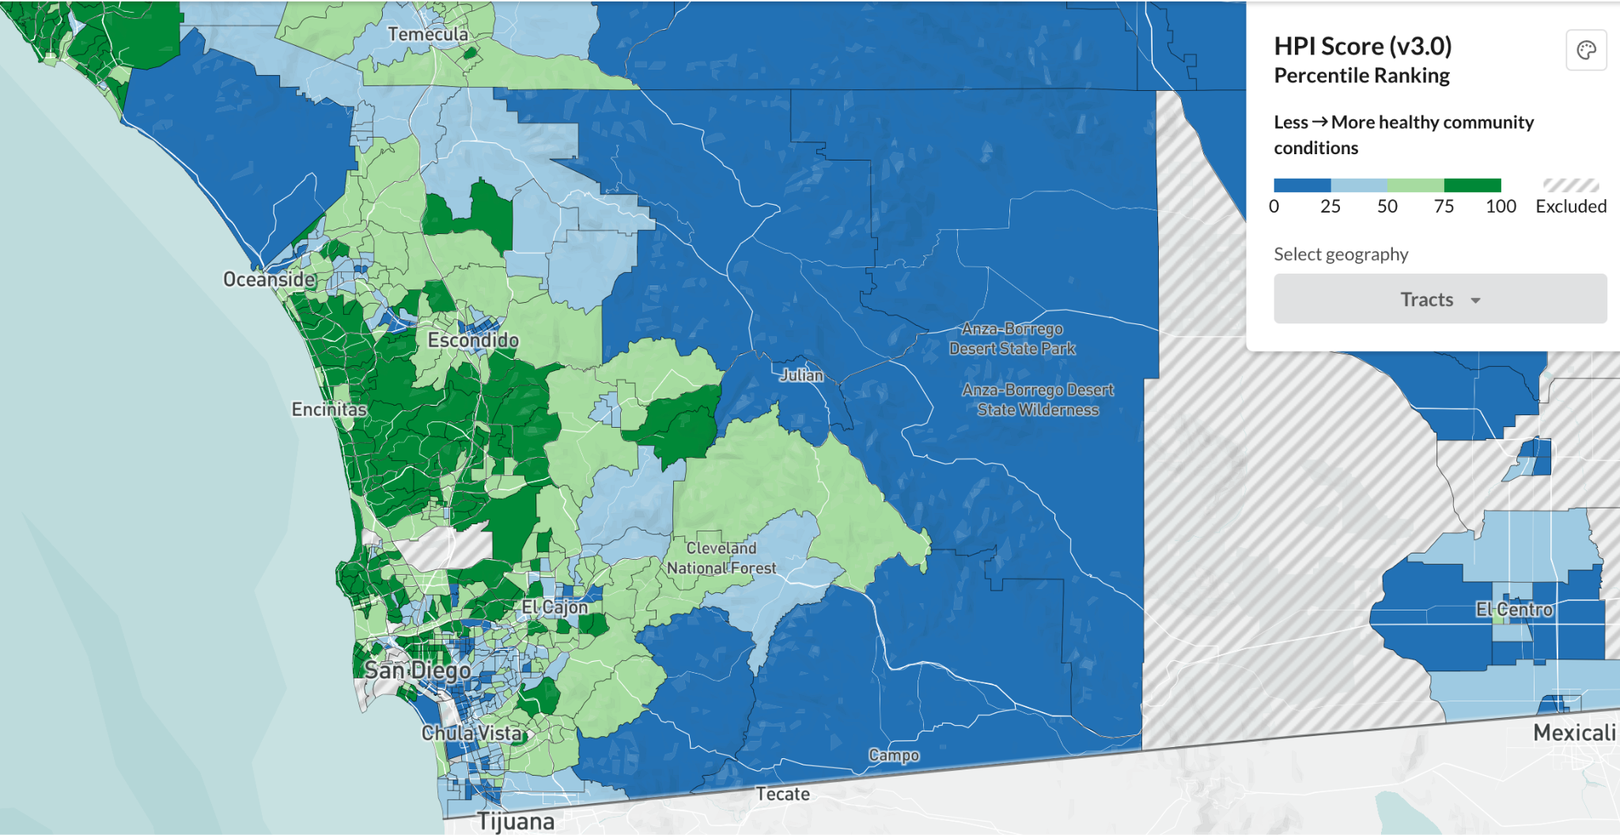
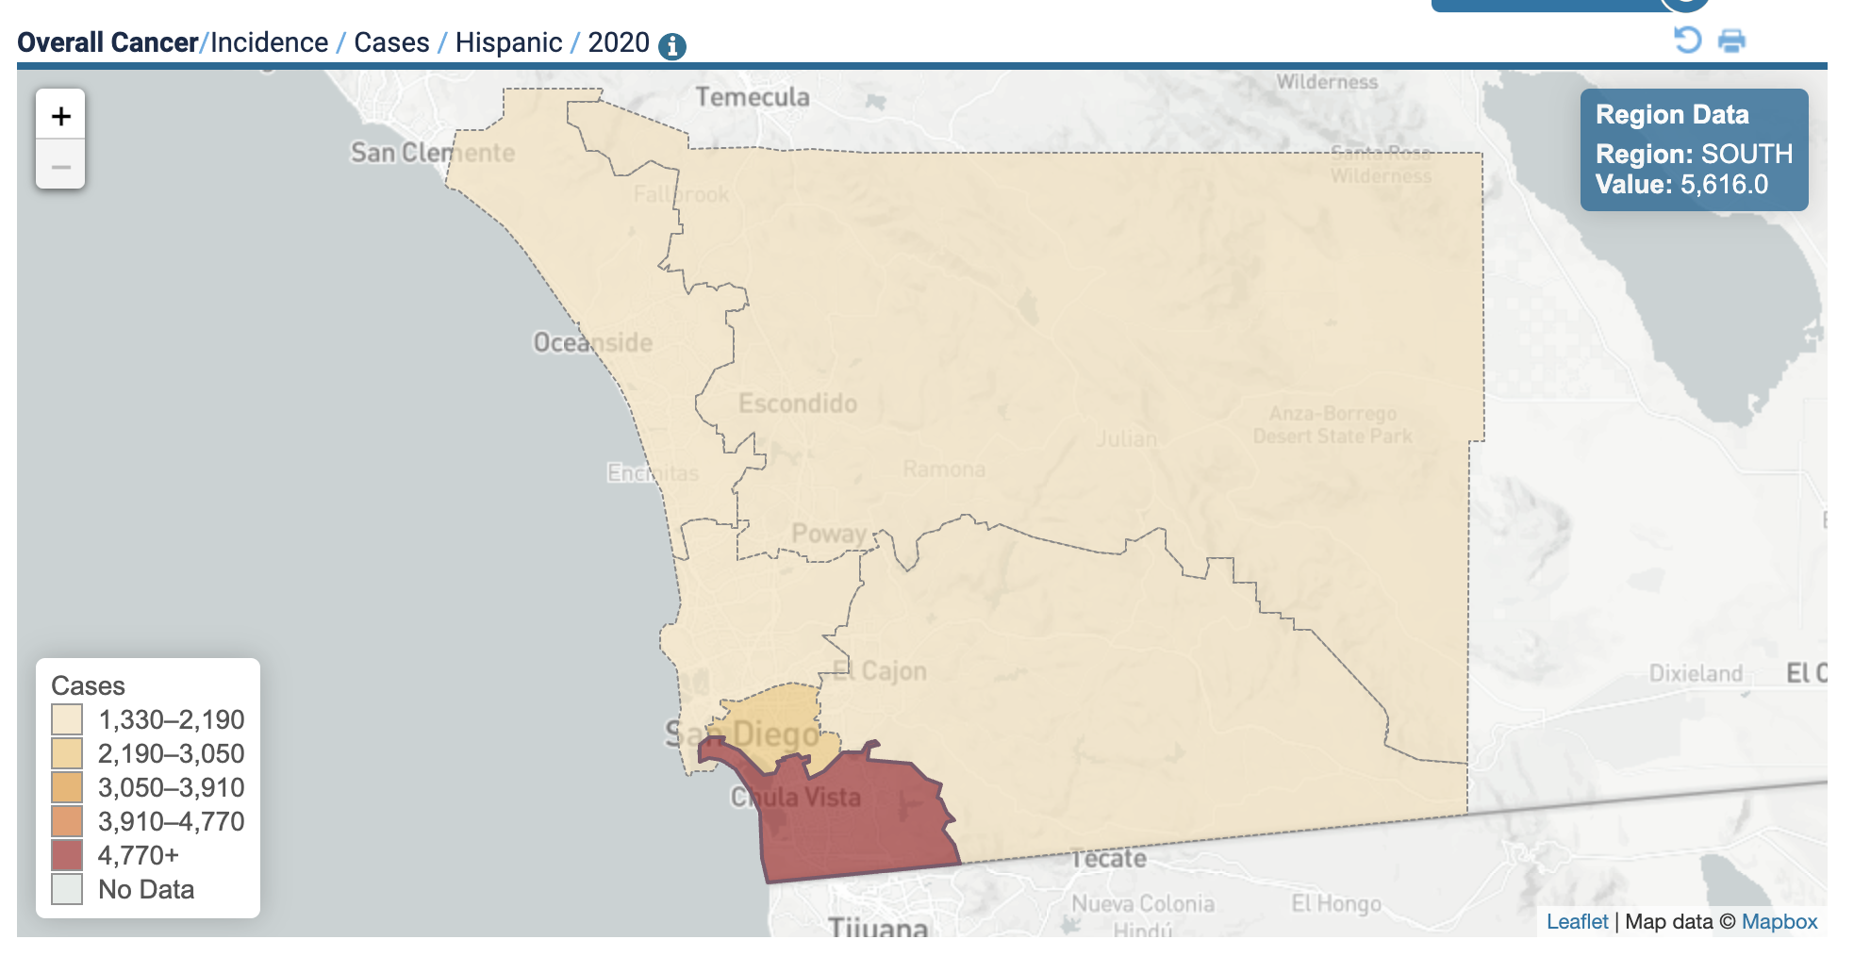
Patient Rating & Commenting
Sources: Moores CancerDAT, 2020
SanGIS, 2020

Slide 15
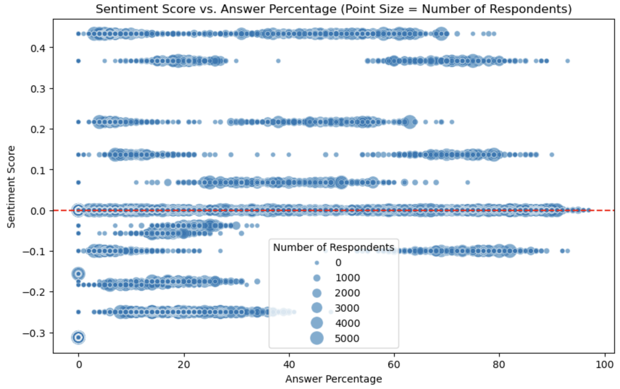
Sentiment Analysis

Slide 16

Moving Forward
Expand on more diseases
Data Security Concerns
Endless Possibilities

Slide 17
Team LEKT
Lisa Nguyen
SDSU, Statistics - Data Science, lnguyen6413@sdsu.edu
Eric Gan UCSD, Data Science, ergan@ucsd.edu
Kyla Ma
UCSD, Computer Science, kym003@ucsd.edu
Toby Zhan
UCSD,

